Slide 1
Why Digital Mammography
Why Digital Mammography
<Facility name>

Slide 2
Why (name of practice)?
(Name of Practice) delivers the highest quality patient care available
Dedicated staff
Commitment to patient care and comfort
Comfortable, easily accessible facility
State-of-the-art technology, including digital mammography

Slide 3
WHY DIGITAL MAMMOGRAPHY?
Lower Patient Dose
Digital mammography delivers 30%-40% lower dose over film & CR (Computed Radiography)
Enhanced Patient Care
Improved workflow for the patient, technologist and radiologist
Needle localizations can be completed in an average of 12 minutes
Elimination of Lost Films
Redundant storage of digital exams eliminates possibility of lost images
Notes:
Here are a few of the reasons why digital mammography is an improvement over film screen & CR mammography.
Lower Patient Dose
Digital mammography delivers 30%-40% lower dose compared to screen-film and CR mammography
Enhanced Patient Care
Elimination of need for technologists to leave exam room to process films provides uninterrupted patient contact
Radiologist can quickly view a digital study
Needle localizations can be completed in an average of 12 minutes
Elimination of Lost Films
Redundant storage of digital exams eliminates possibility of lost images

Slide 4
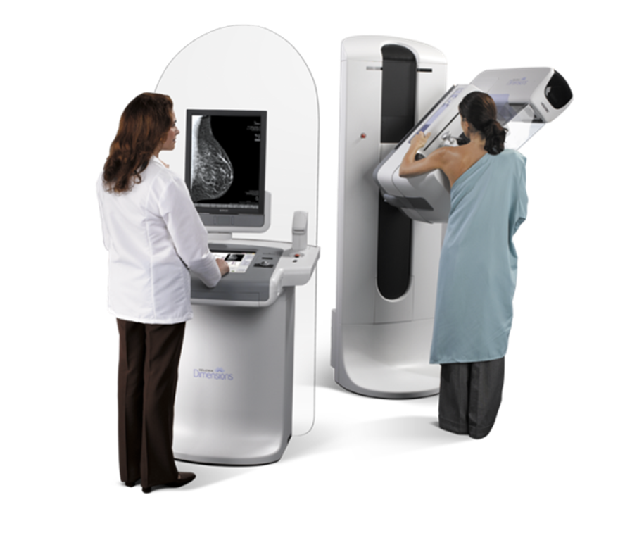
WHAT IS DIGITAL MAMMOGRAPHY?
Utilizes traditional X-ray generators and tubes to produce an X-ray beam
This X-ray beam is converted into digital information which can be stored electronically, transmitted, displayed, analyzed and manipulated in a number of ways
Notes:
What is Digital Mammography?
Digital mammography uses x-ray generators and x-ray tubes to produce an x-ray beam. This is the same method that was utilized for film/screen mammography.
The difference is how the detector receives the x-ray beam. The x-ray beam is converted into digital information; this electronic information can be stored, transmitted, displayed and manipulated electronically.

Slide 5
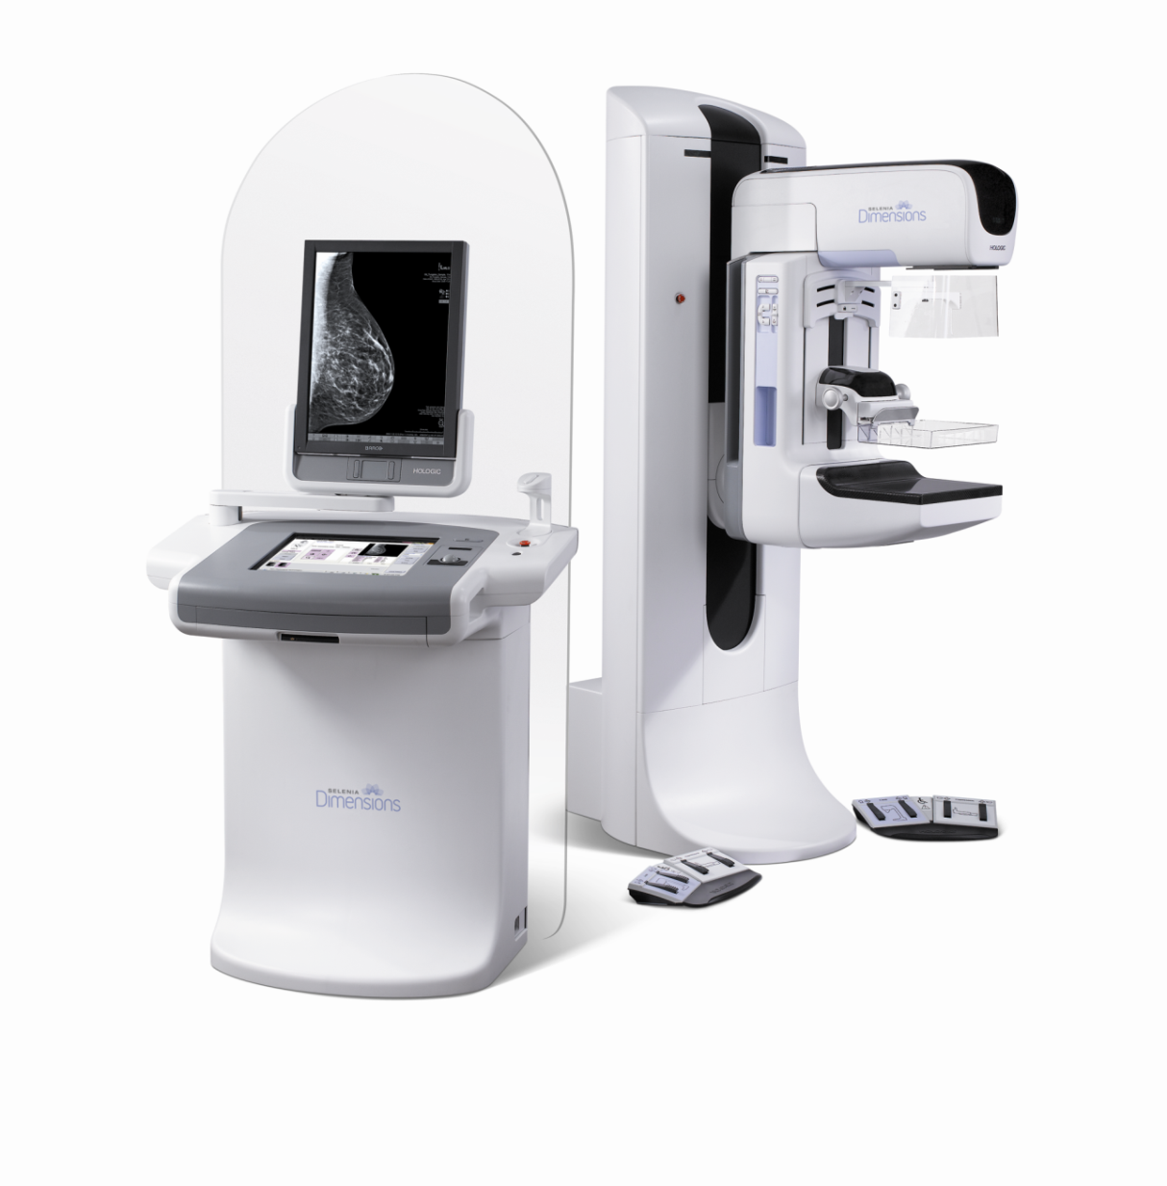
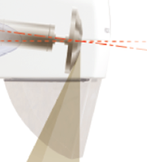
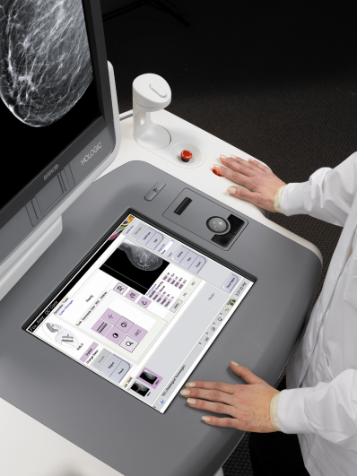
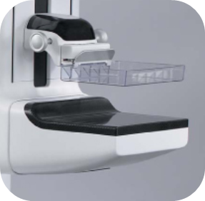
WHAT IS DIGITAL MAMMOGRAPHY?
X-ray source
Acquisition computer
Digital detector
Notes:
The mammography technologist will position the patient for the examination. (CLICK 3 times to display detector)The patient’s breast is placed on top of the digital detector.
Using the acquisition computer, (CLICK 3 times to display) the technologist will begin acquiring the image. The x-ray beam is generated (CLICK 3 times) and the information is sent back to the acquisition computer.

Slide 6
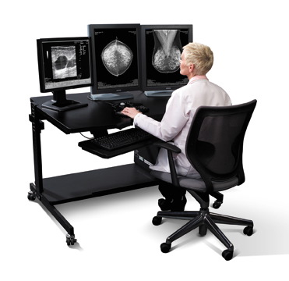
DIGITAL MAMMOGRAPHY
Softcopy display
Notes:
After the mammography technologist has acquired the mammography images, the images are sent electronically to the radiologist’s softcopy display.

Slide 7
Improved Image Quality
MLO Right
Digital mammogram
MLO right
Screen-film mammogram
Notes:
These two images represent the difference in image quality between a digital mammography and a screen-film mammography.
The structures of the breast tissue are well defined with digital mammography.

Slide 8
Improved Image Quality
MLO Left
Digital mammogram
MLO Left
Screen-film mammogram
Notes:
Here is another example of improved image quality with digital mammography.

Slide 9
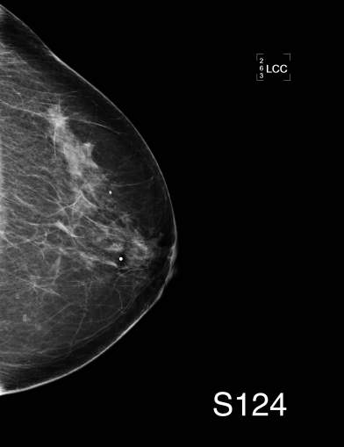
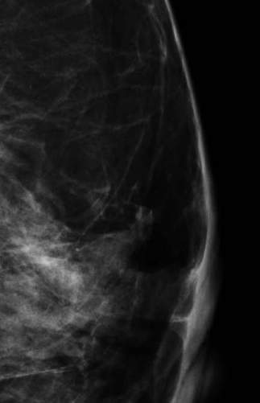
Digital Magnification
Notes:
A digital mammography system still allows for traditional imaging, but one of the benefits for the radiologist is the availability of tools for reviewing the digital mammography images.
At the softcopy review workstation, the radiologist is able to electronically magnify areas within the breast for a closer review.

Slide 10
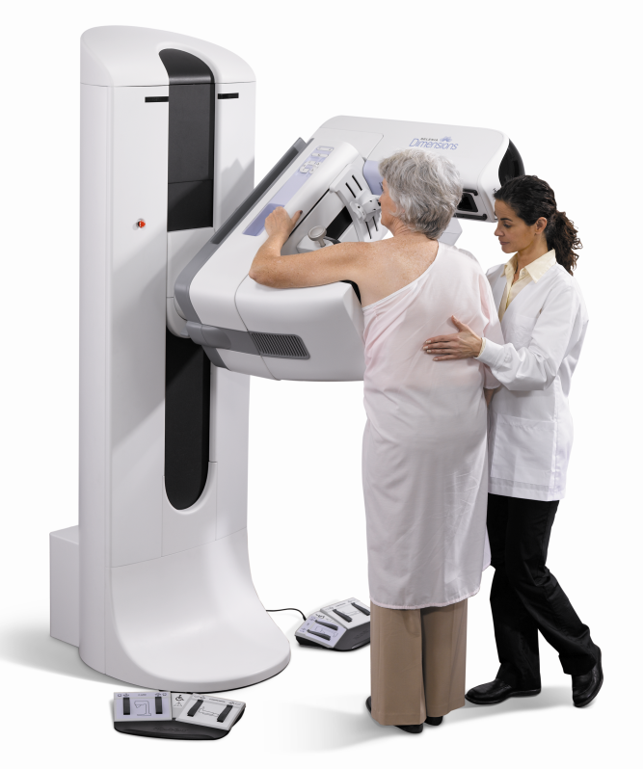
Why (name of practice)?
We chose the digital mammography system that delivers:
Optimal resolution
Lower patient dose with no compromise in image quality
Emphasis on patient comfort

Slide 11
IMAGE IS EVERYTHING...Especially In Mammography
Mammography requires images of the highest resolution and contrast for the detection of cancer at the earliest stages
Our digital mammography system provides the latest technological advances available to ensure superb image quality
Direct capture digital detector completely eliminates the image-degrading effects of light diffusion, for preservation of image sharpness
Exclusive High Transmission Cellular Grid reduces radiation scatter in two directions and enables 70% - 80% transmission of primary beam, compared to conventional grids that provide only 50% transmission

Slide 12
Encourage Someone You Love To Have Her Annual Mammogram.

